Slide 1
4K DDFCH Design Discussion
Jerry Chang

Slide 2
Outline
Expected Design Change
Design Spec.
  Input interface
  Output interface
Design Review

Slide 3
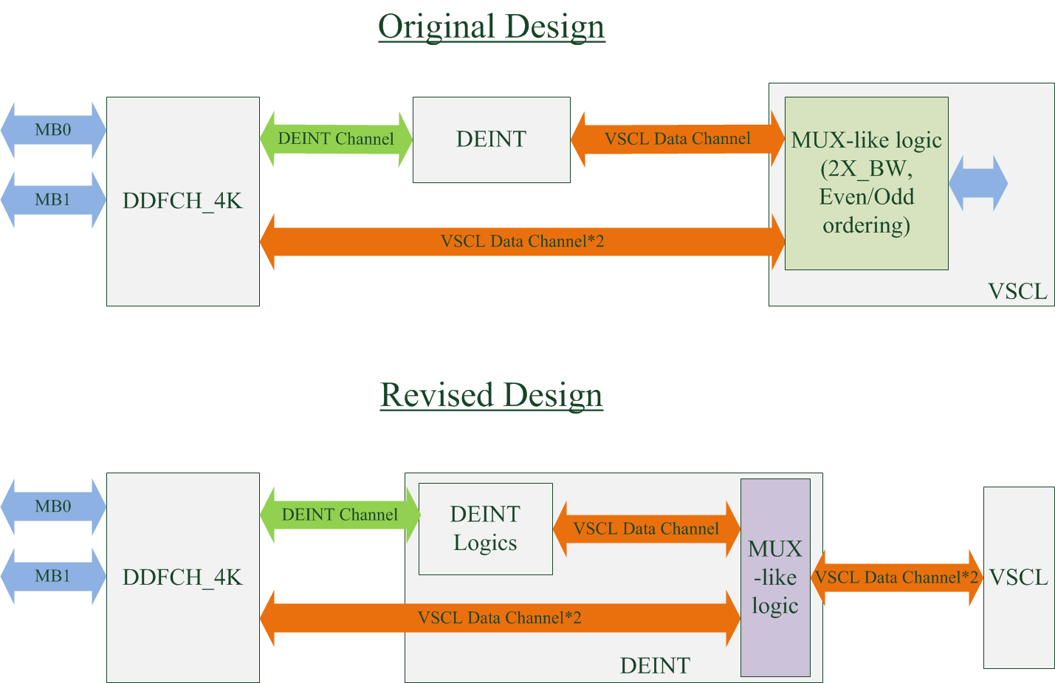
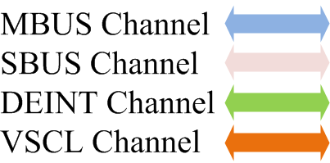
Expected Design Change

Slide 4
Design Spec.
Input
  Interface : MBUS
DDFCH Fetching Requirement |  | OCP command |  | Pattern Confirm?
Fetching Data Type | Functions | Burst length | Cmd Type
Uncompressed (IPBG Path) | 8-bit linear data fetching | 16/8 | linear | YES
 | 10-bit linear data fetching | 16/8 | linear | YES
 | 8-bit data fetching, 2D frame_mode (H265_EN=0) | 16 | 2D | NO
 | 8-bit data fetching, 2D field mode (H265_EN=1) | 16 | 2D | NO
Compressed (WAV412) | 8-bit data fetching 10-bit data fetching | 8/2 | linear | YES
Related patterns:
Uncompressed, 8-bit linear data fetching : make VPP_1080P
Uncompressed, 10-bit linear data fetching : make VPP_1080P_wave412_10bit_480P_smallwindow
Compressed, 8-bit data fetching : make VPP_3840x2160_comp_8bit.v
Compressed, 10-bit data fetching : make VPP_3840x2160_comp.v

Slide 5
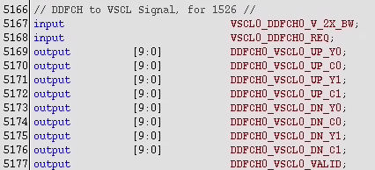
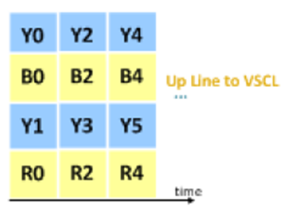
Design Spec.
Output (VSCL)
  Interface (will change to DEINT0_VCSL0_*)
  Format: YUV422 (UP/DN, one channel)
  Fetching Order (e.g., 1080P):
    (0,0) → (0,1919)→(1,0)→(1,1919)→…→(1079,1979)
  Endian: MSB alignment

Slide 6
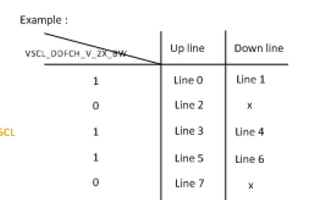
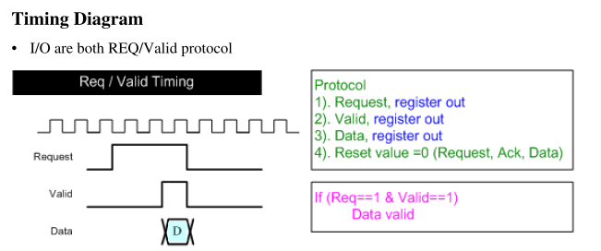
Design Spec.
VSCL Interface
Source: Copied from IP Spec. of DDFCH 1526

Slide 7
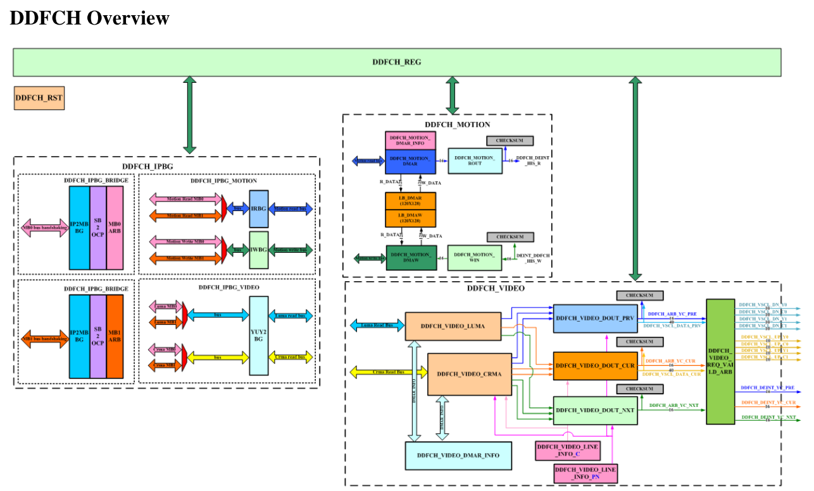
Design Review
Data Flow (LUMA):
DDFCH_IPBG_BRIDGE→DDFCH_IPBG_VIDEO→DDFCH_VIDEO_LUMA→
DDFCH_VIDEO_DOUT→DDFCH_VIDEO_REQ_VALID_ARB

Slide 8

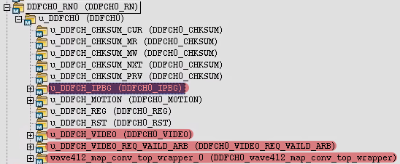
Design Review
DDFCH_IPBG
  Bridge between Function (Luma/Chroma fetching) and Bus interface (MBUS)
DDFCH_VIDEO
  Luma/Choma Data fetching
  Pervious/Current/Next frame data reordering
  YUV422 up-sampling
  10-bit alignment problem in 128-bit bus data width
DDFCH_VIDEO_REQ_VALID_ARB
  Data Mux to VSCL and DEINT
Wave412_map_conv_top_wrapper
  Decompression

Slide 9
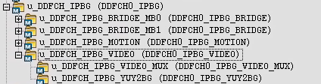
DDFCH_IPBG
BRIDGE_MB0
BRIDGE_MB1
IPBG_VIDEO

Slide 10
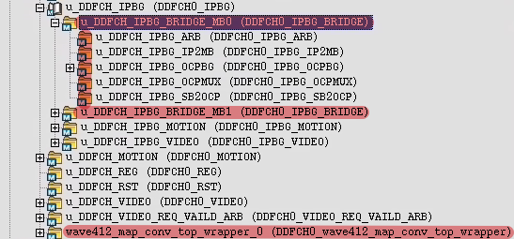
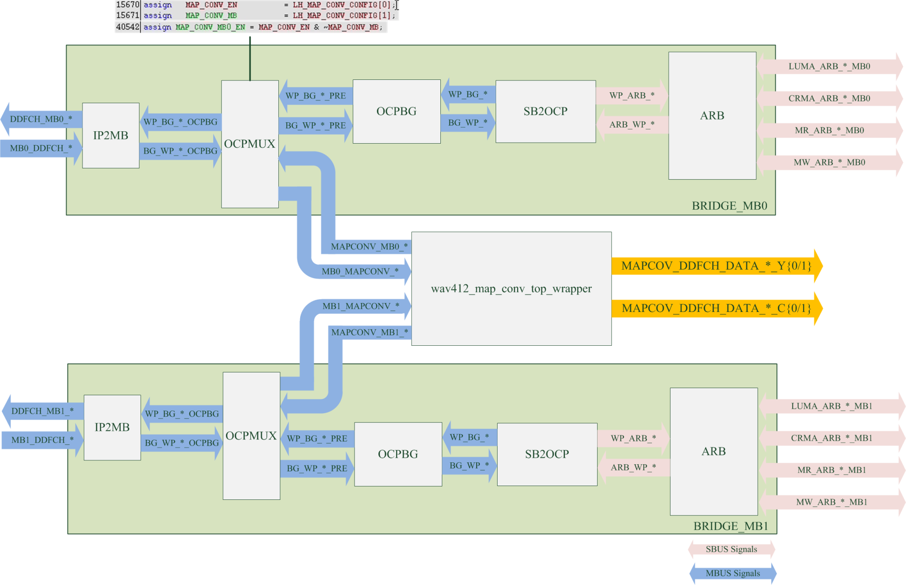
DDFCH_IPBG – BRIDGE_MB*

Slide 11
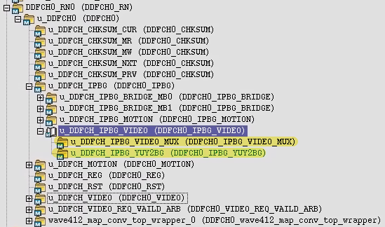
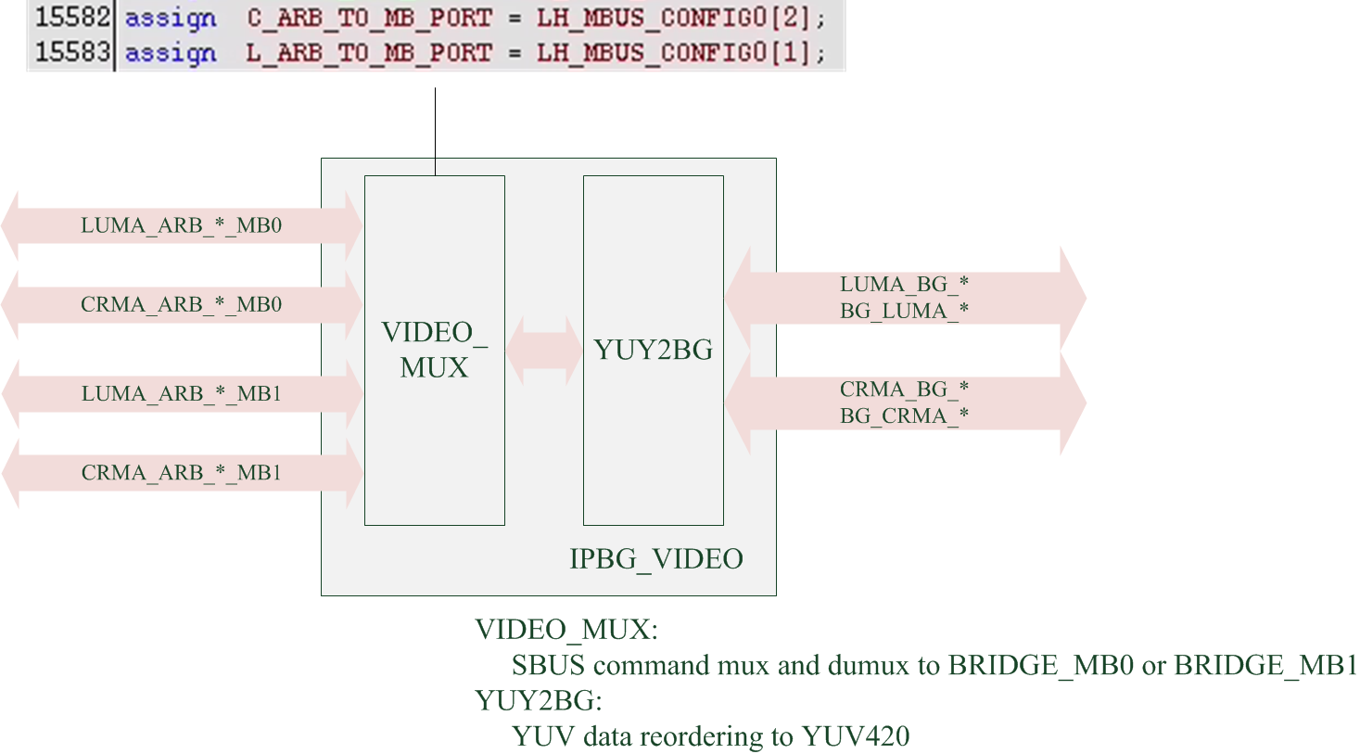
DDFCH_IPBG – IPBG_VIDEO

Slide 12
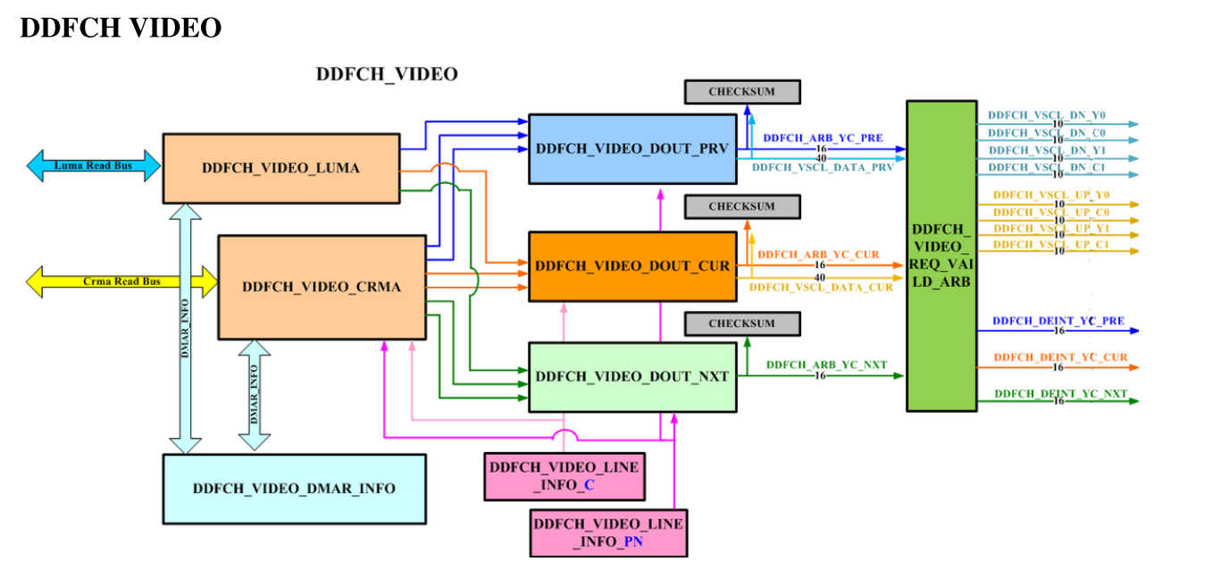
DDFCH_VIDEO
DDFCH_VIDEO_*
  DDFCH_VIDEO_LUMA
  DDFCH_VIDEO_CRMA
VIDEO_DOUT
  DDFCH_VIDEO_DOUT_PRV
  DDFCH_VIDEO_DOUT_CUR
  DDFCH_VIDEO_DOUT_NXT
DDFCH_VIDEO_REQ_VALID_ARB
\\10.209.160.13\tr0200\IP\DISP\DISPLAY doc\1526_IP-SPEC\IP-Spec-DDFCH 1526.pdf

Slide 13
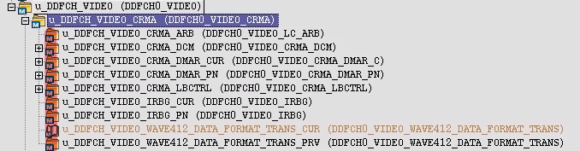
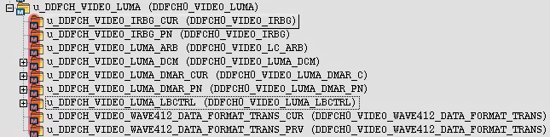
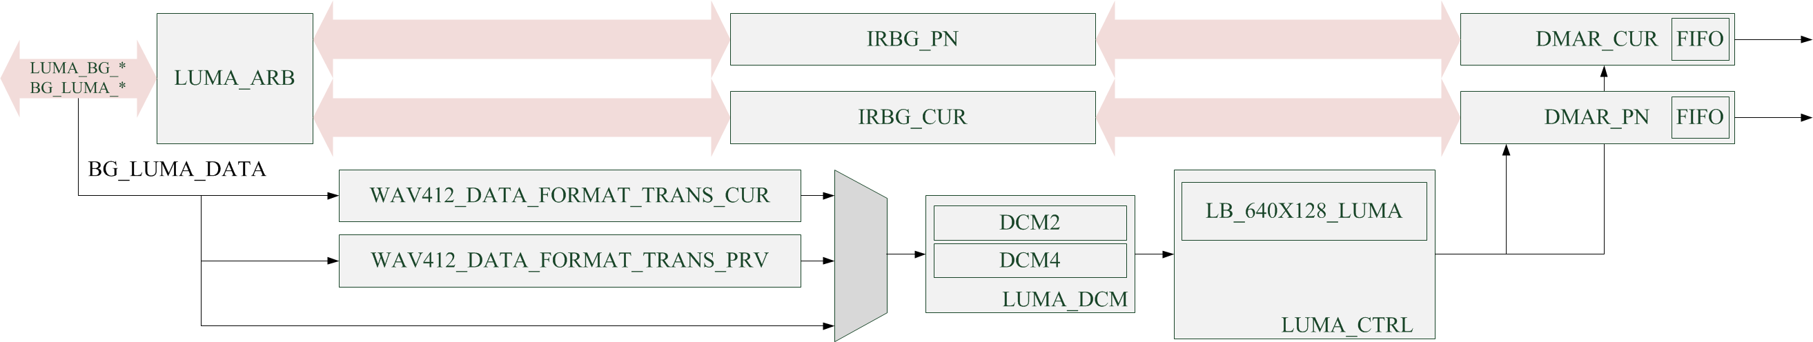
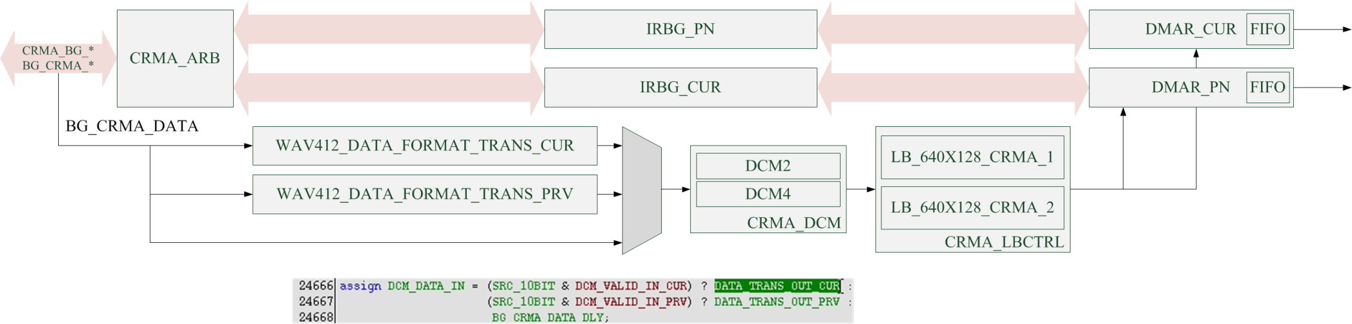
DDFCH_VIDEO – DDFCH_VIDEO_*
VIDEO_LUMA
VIDEO_CRMA
Notes:
CRMA_ARB:
SBUS command queue + Arbitration.
DMAR_CUR:
Read command sender for current frame/field.
DMAR_PN:
Read command sender for pervious/next frame/field.
CRMA_DCM:
Down-sampling
WAV412_DATA_FORMAT_TRANS_*:
No description in spec.
(Solve non-alignment problem when 10-bit raw data in 64-bit bus data width)

Slide 14
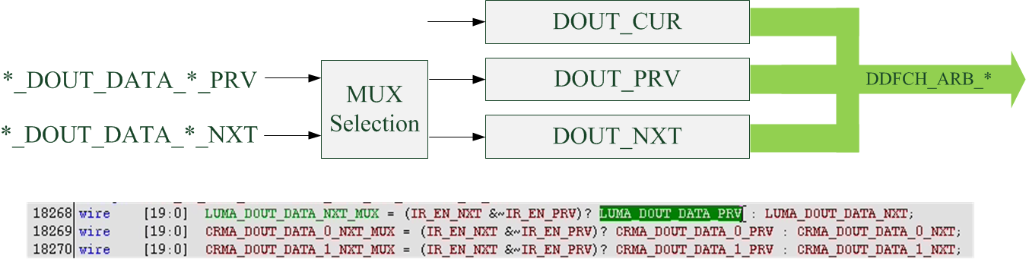
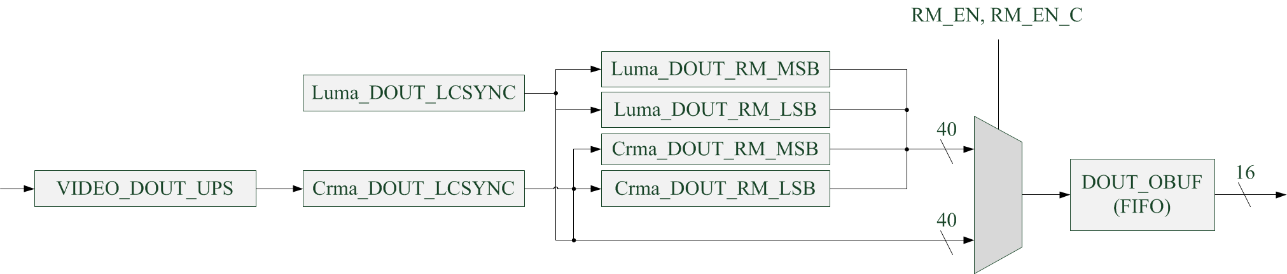
DDFCH_VIDEO – VIDEO_DOUT

Slide 15
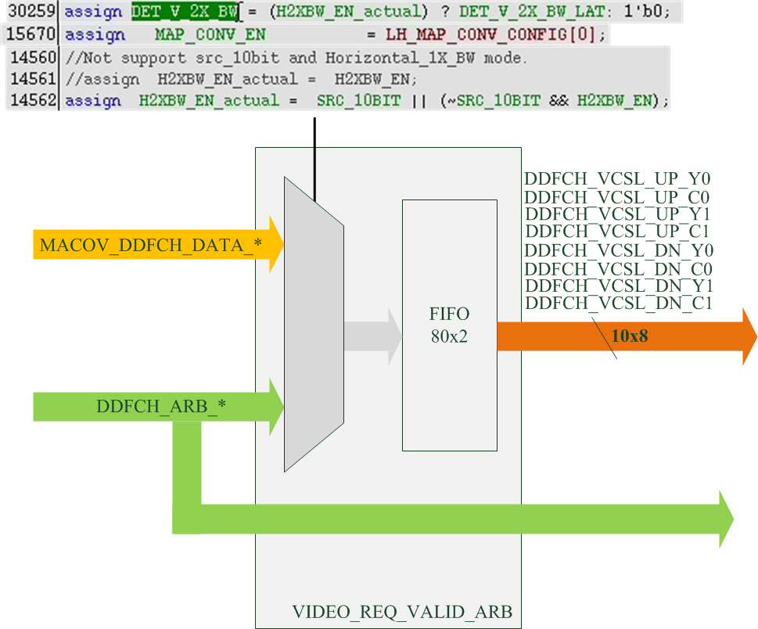
DDFCH_VIDEO – DDFCH_VIDEO_REQ_VALID_ARB

Slide 16
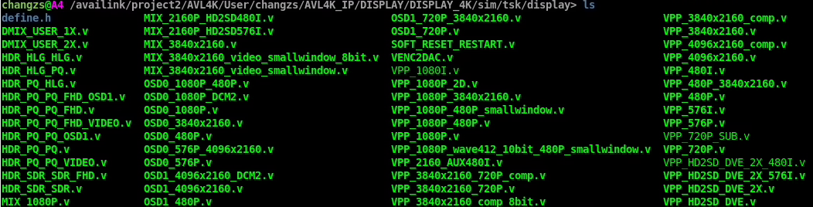
Pattern Status

